Slide 1
Data Link Layer

Slide 2
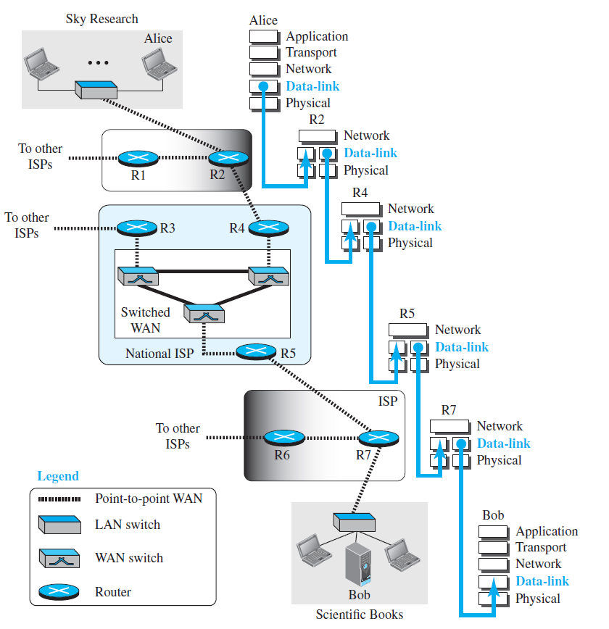
Communication in the data link layer

Slide 3
Services of data link layer
Node-to-node delivery
Framing
Flow control
Error control

Slide 4
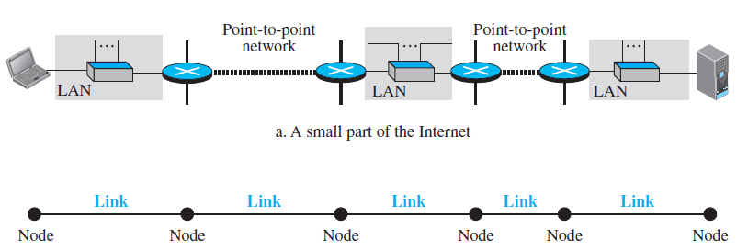
Node-to-node delivery
Communication at the data link layer is node-to-node.
Data link layer of a node is responsible for delivering a datagram to the next node in the path.

Slide 5
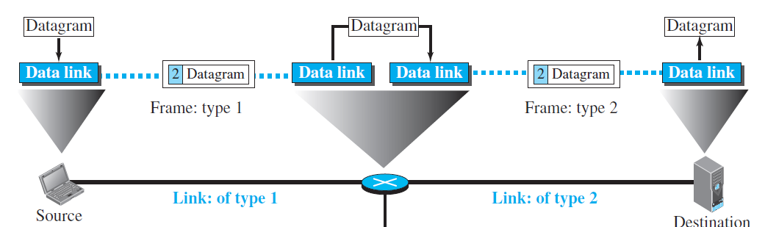
Node-to-node delivery
Encapsulation at the sender, decapsulation at the receiver, both encapsulation and decapsulation at intermediate nodes.

Slide 6
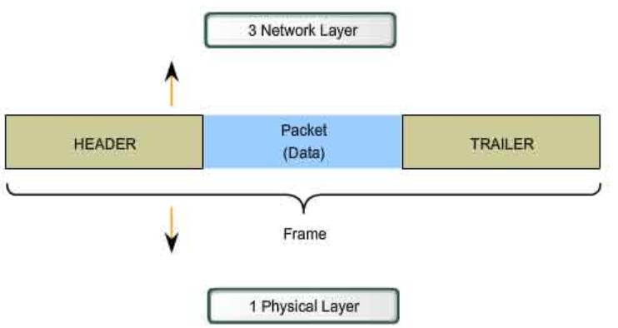
Framing
Datagram received from the network layer is encapsulated into a frame.
Frame can have both a header and a trailer.

Slide 7
Flow control
The rate at which a sender is sending data may not be the same as that at which the receiver can handle.
Receiver can use a buffer to temporarily store the data before processing them.
Issue: buffer is limited in size
Consequence
Frames are dropped at the destination if buffer is full.
Receiver sends a feedback to the sender to slow down.

Slide 8
Error control
Frames are converted to bits, then to signals.
Signals are prone to errors, data received needs to be checked for errors.
On detection of errors, the following can be done:
Correction at the destination
Receiver discards the data
Sender asked to retransmit

